Slide 1
Natural Language Processing
Week 9

Slide 2
Good evening, everyone. Welcome to the live session.
Today, we will be practicing problems from the current week’s content.
We will wait 5 minutes for everyone to join in and start at 7:05 pm.

Slide 3
Question 1: How does Correlated Topic Model create relations among topics?
1. By having lots of general words inside the topics
2. By Removing stop-words
3. By using logistic normal distribution
4. None of the above

Slide 4
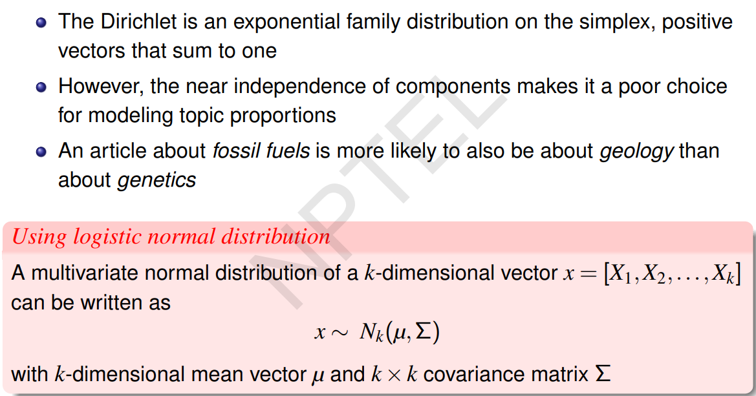
Solution
Answer: 3

Slide 5
Question 2: Choose the correct statement from below –
I. A low value of alpha will assign fewer topics to each document whereas a high value of alpha will have the opposite effect.
II. A low value of beta will use fewer words to model a topic whereas a high value will use more words, thus making topics more similar between them.
III. LDA cannot decide on the number of topics by itself.
1. (I).
2. (II).
3. III).
4. All of the above.

Slide 6
Solution
Answer: 4
Solution:
All of the above

Slide 7
Question 3. Vikram has lots of documents and he wants to model the content as well as connections.
Which topic modelling technique will be suitable for it?
1. Correlated Topic Model
2. Relational Topic Model
3. Dynamic Topic Model
4. Supervised Latent Dirichlet Allocation

Slide 8
Solution
Question 3. Vikram has lots of documents and he wants to model the content as well as connections.
Which topic modelling technique will be suitable for it?
1. Correlated Topic Model
2. Relational Topic Model
3. Dynamic Topic Model
4. Supervised Latent Dirichlet Allocation
Answer: 2

Slide 9
Question 5: You have a topic model with the parameters α = 0.9 and β = 0.05. Now, if you want to have sparser distribution over words and denser distribution over topics, what should be the values for α and β?
1. Both α and β values should be decreased
2. Both α and β values should be increased
3. α should be decreased, but β should be increased
4. α should be increased, but β should be decreased

Slide 10
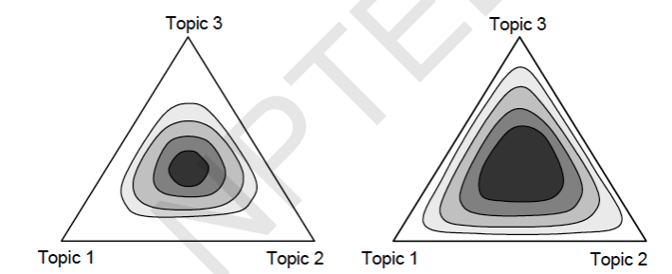
Solution
Answer: 4
Solution:
α : topic distribution
β : word distribution
Therefore, α should be increased, but β should be decreased.

Slide 11
Question 4: In Topic modeling which hyperparameters tuning used for represents document-topic Density?
1. Dirichlet hyperparameter Beta
2. Dirichlet hyperparameter alpha
3. Number of Topics (K)
4. None of them

Slide 12
Solution
Answer: 2
Solution: alpha is used to represent document-topic intensity

Slide 13
Question 6 :
In Gibbs sampling choose the correct option from below
1. It can not directly estimate the posterior distribution over z
2. It is a form of Markov chain Monte Carlo
3. Here sampling is done in parallel
4. Sampling is stopped before sampled values approximate the target distribution

Slide 14
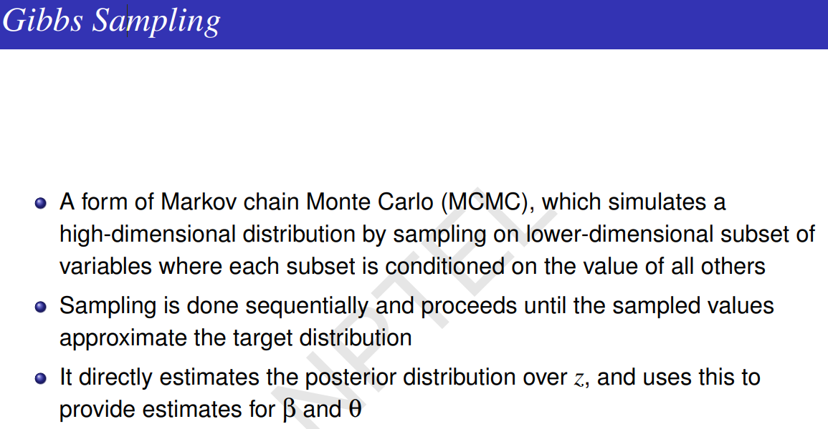

Slide 15
Solution
Answer: 2
Solution: In gibbs sampling, we do sequential sampling until the sampled values approximate the target distribution. This also can directly estimate the posterior distribution over z.

Slide 16
Question 7 : Which of the following is/ are true ?
1. Dirichlet distribution is a family of exponential distribution
2. LDA is impacted by the order of documents
3. In LDA the number of latent clusters are identified automatically
4. All of the above are true

Slide 17
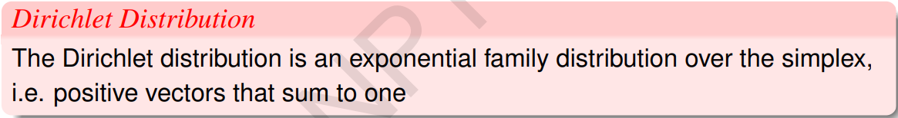
Solution
Answer: 1
Solution:
The order of documents does not matter in LDA, we need to identify the number of latent clusters in advance in the LDA topic model.

Slide 18
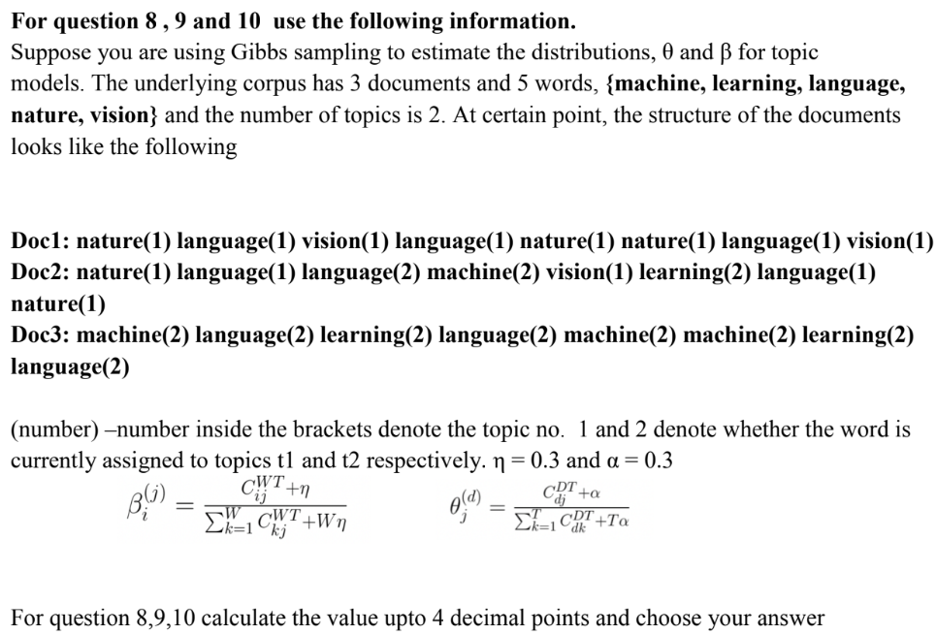

Slide 19
Question 8 : Using the above structure the estimated value of β_{nature}⁽²⁾ at this point is
1. 0.0240
2. 0.02459
3. 0.0260
4. 0.0234

Slide 20
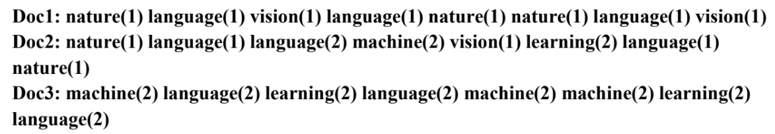
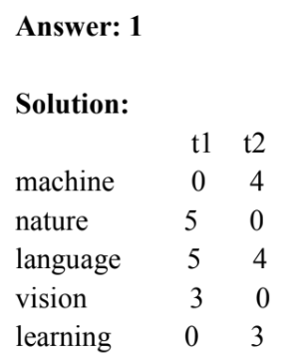
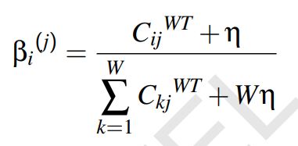
Solution
β_{nature}⁽²⁾ = (0+0.3)/(11+5*0.3) = 0.3/12.5 = 0.024

Slide 21
Question 9 : Using the above structure the estimated value of θ_{t1}^{doc2}
1. 0.6562
2. 0.6162
3. 0.6385
4. 0.50000

Slide 22
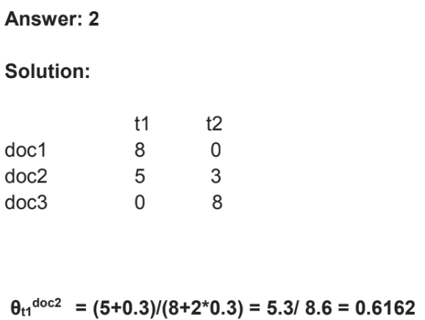
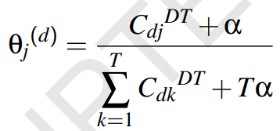
Solution

Slide 23
Question 10 : Using the above structure the estimated value of θ_{t2}^{doc2}
1. 0.6562
2. 0.3975
3. 0.3837
4. 0.3707

Slide 24
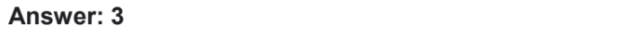
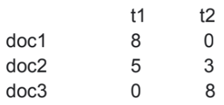
Solution
θ_{t2}^{doc2} = (3+0.3)/(8+2*0.3) = 3.3/8.6 = 0.3837

